Slide 1
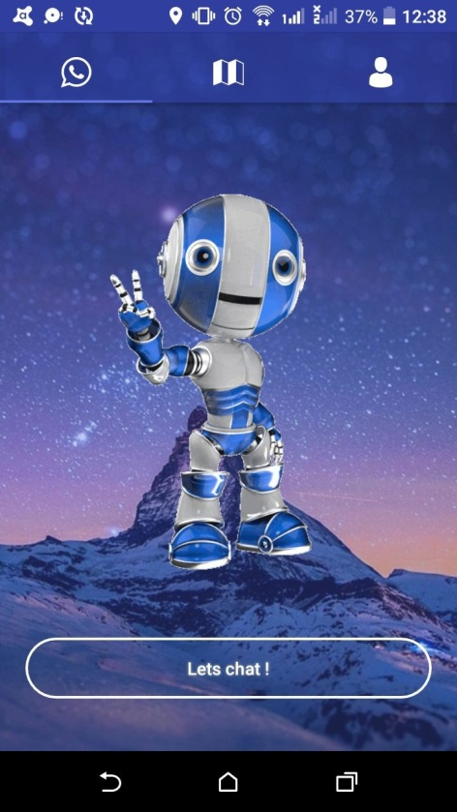
AMIGO
A Stress Buster BOT...
-Team ATOM

Slide 2
Aim: The aim of the product is to identify the stress level and let the bot try to cheer up the user.
The product also provides information about the nearby therapist for consultation.

Slide 3
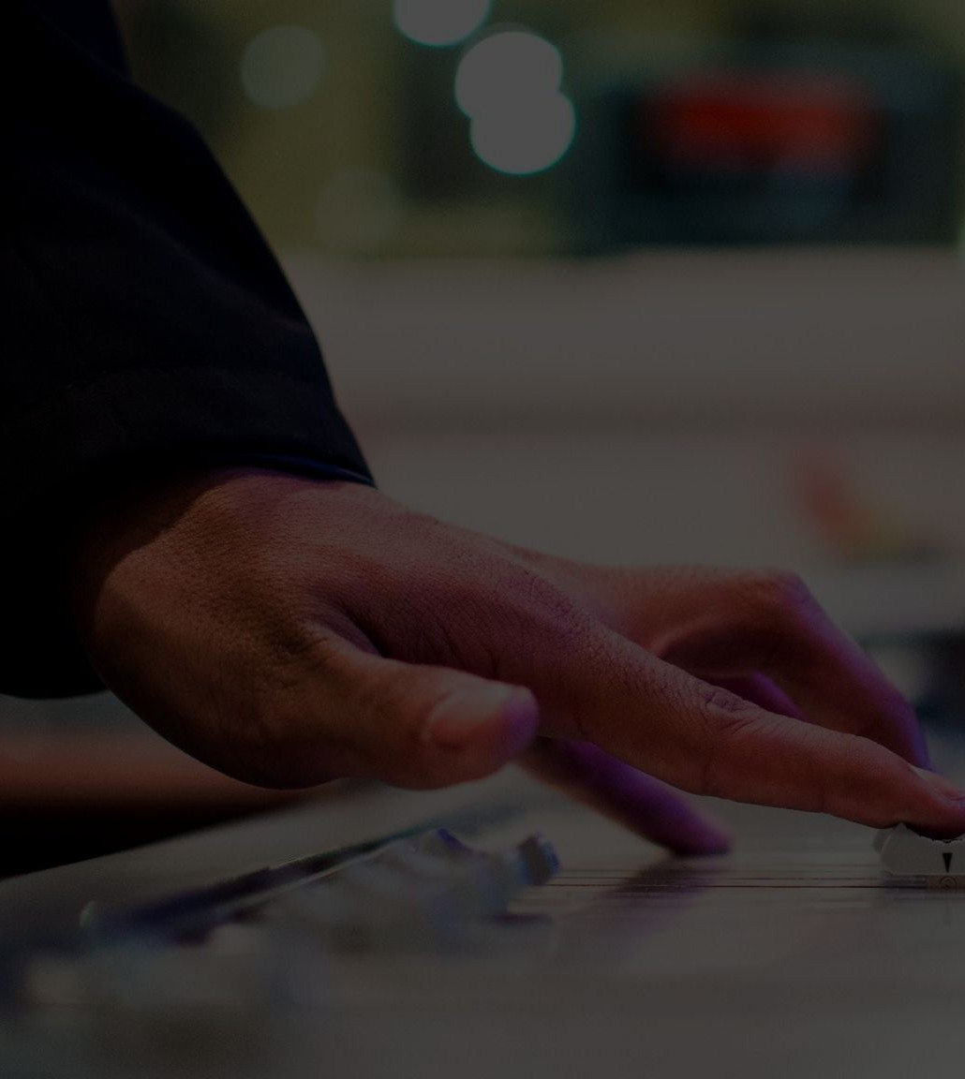
Stress Management
A high 46% of the workforce in organizations in India suffers from some or the other forms of stress leading to hypertension and other severe health problems. Develop a solution to reduce the stress levels of citizens.
The problem

Slide 4

The solution
To overcome this, the team has come up with the idea of an AI stress buster chatbot to try to cheer up the user and provides information about the nearby therapist for consultation.

Slide 5
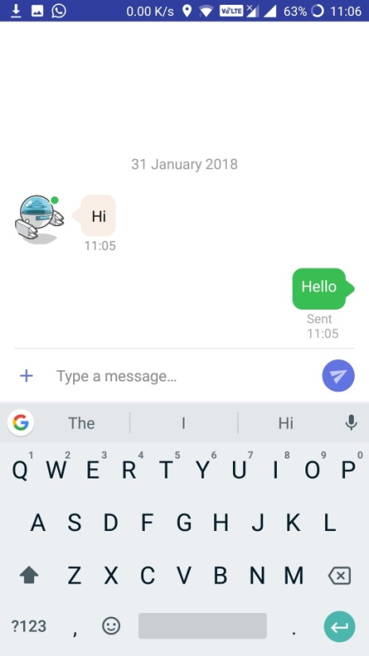
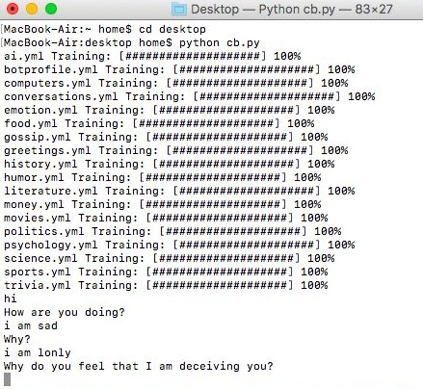
AI ChatBot
The chatbot chats with the person via speech input and it gives the output to the user in voice format so that the user does not feels that he is chatting to a bot.

Slide 6



Components
The application is divided into three different modules
AI ChatBot to relieve stress
Sentiment Analysis through Speech Input
Suggesting Nearby Therapist

Slide 7
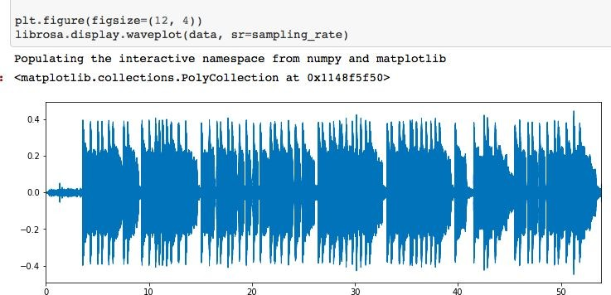
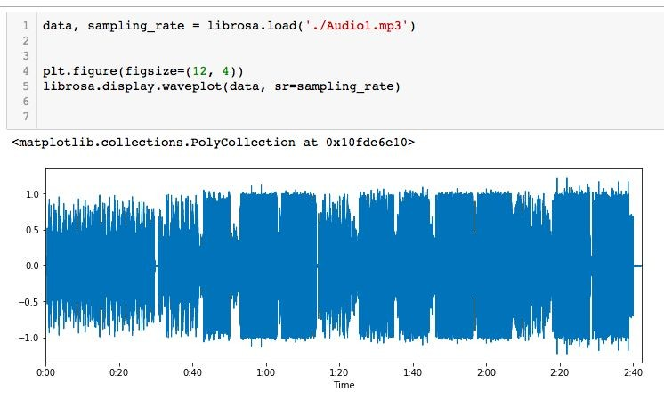
Stress Recognition
The application uses speech recognition to determine the level of stress by recognising the level of amplitude of the person while talking.

Slide 8
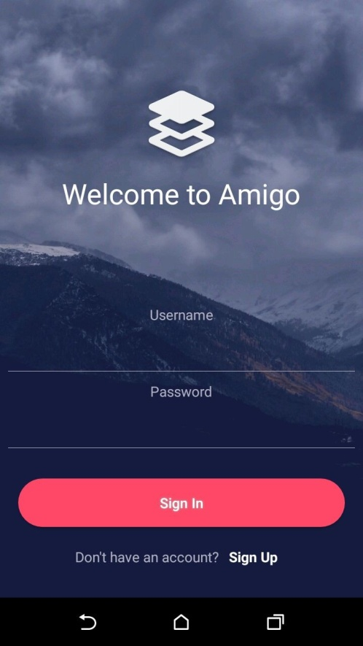
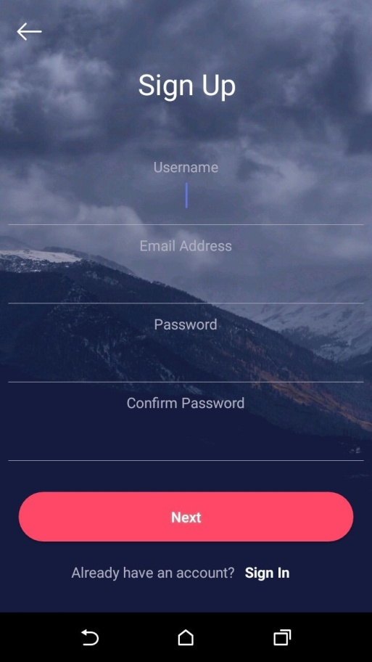
Landing Page
The home screen consists of a login and sign up page where the user needs to feed in his/her information for the bot to analysis the person.

Slide 9
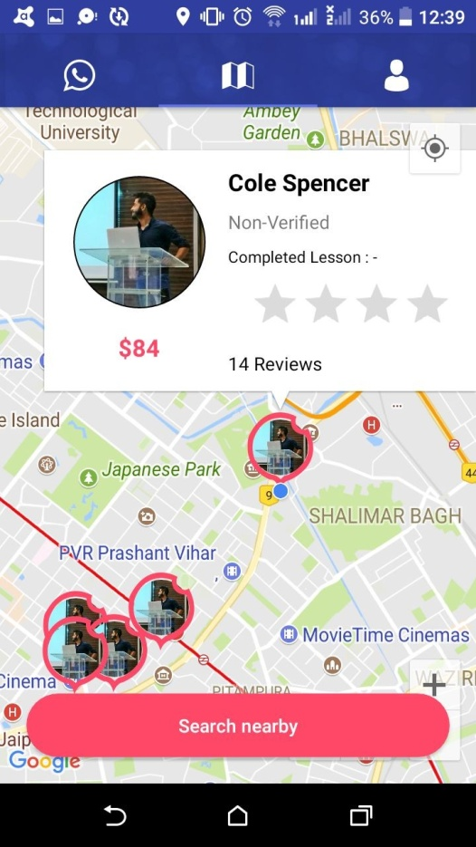
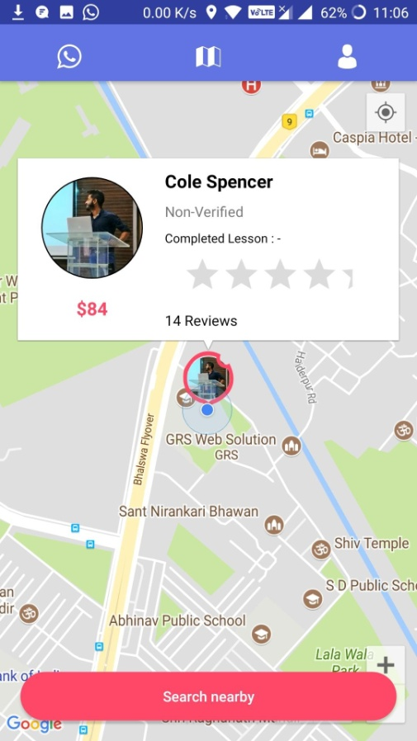
Nearby Therapist
This part of the application suggests the nearby therapist.

Slide 10
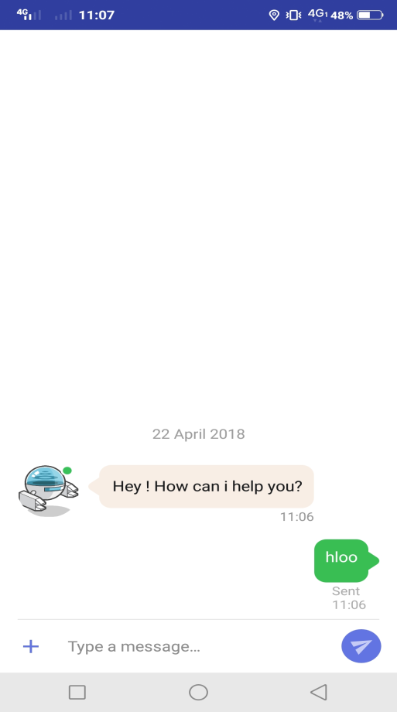
CHAT INTERFACE
User Friendly material design interface for chatting which allows the user to send text via typing or speech.

Slide 11
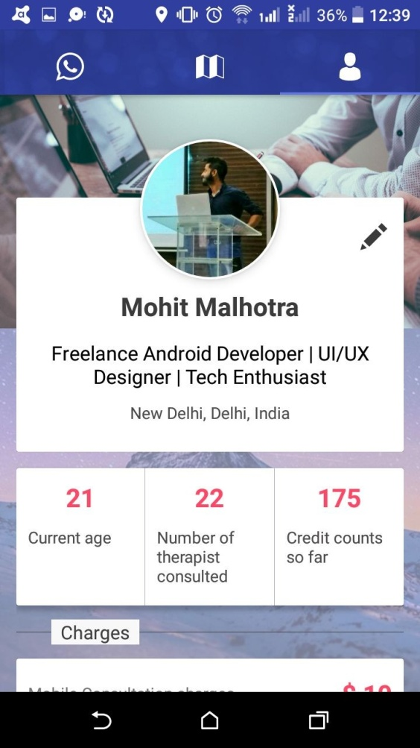
Profile Tab
This part of the application displays the complete information about the therapist.

Slide 12
This application can be extended further in many possible ways and some of them are listed below:
Many more features like stress detection through facial expressions.
Training the bot on data fetched from therapist for better results
The application algorithm and logic can be modified to improve the performance of application.
Future Scope

Slide 13

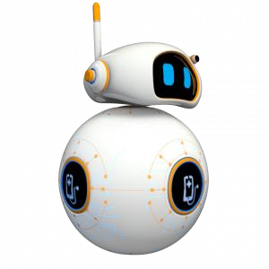
Thank You

